Slide 1
Objectives
i. Hands on a basic navigations in Power BI
ii. Connecting Power BI to excel
iii. Connecting to csv file
iv. Connecting to data base
v. Managing relationship in powerbi
iii. Exploring properties of the canvas
iv. Adding text boxes and images
v. Stacked Bar and Column Charts with all options covered
vi. Changing aggregate functions and showing %Age totals

Slide 2
Power BI Desktop Interface
Power BI Desktop Interface:
The Report has five main areas:
1. Ribbon: The Ribbon displays common tasks associated with reports and visualizations;
2. Pages: The Pages tab area along the bottom allows you to select or add a report page;
3. Visualizations: The Visualizations pane allows you to change visualizations, customize colors or axes, apply filters, drag fields, and more;
4. Fields: The Fields pane, allows you to drag and drop query elements and filters onto the Report view, or drag to the Filters area of the Visualizations pane;
5. Views Pane: There are three types of views in the views pane
▪ Reports View – allows you to create any number of report pages with visualizations.
▪ Data View – allows you to inspect, explore, and understand data in your Power BI Desktop model.
▪ Relationship or Model view – allows you to show all of the tables, columns, and relationships in your model.

Slide 3
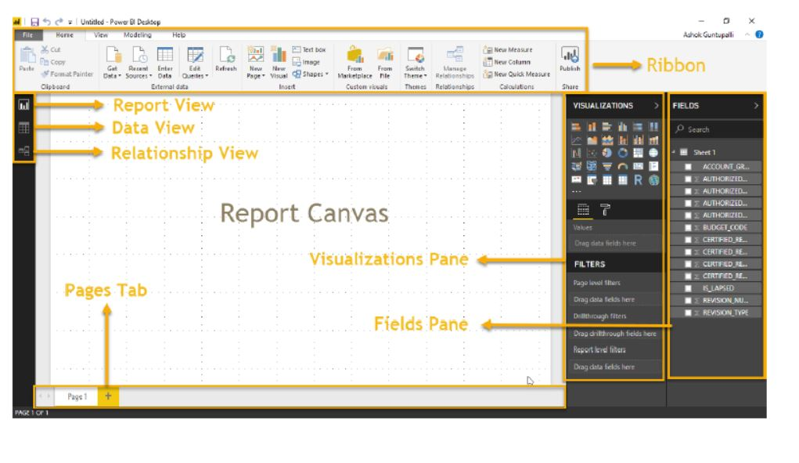

Slide 4
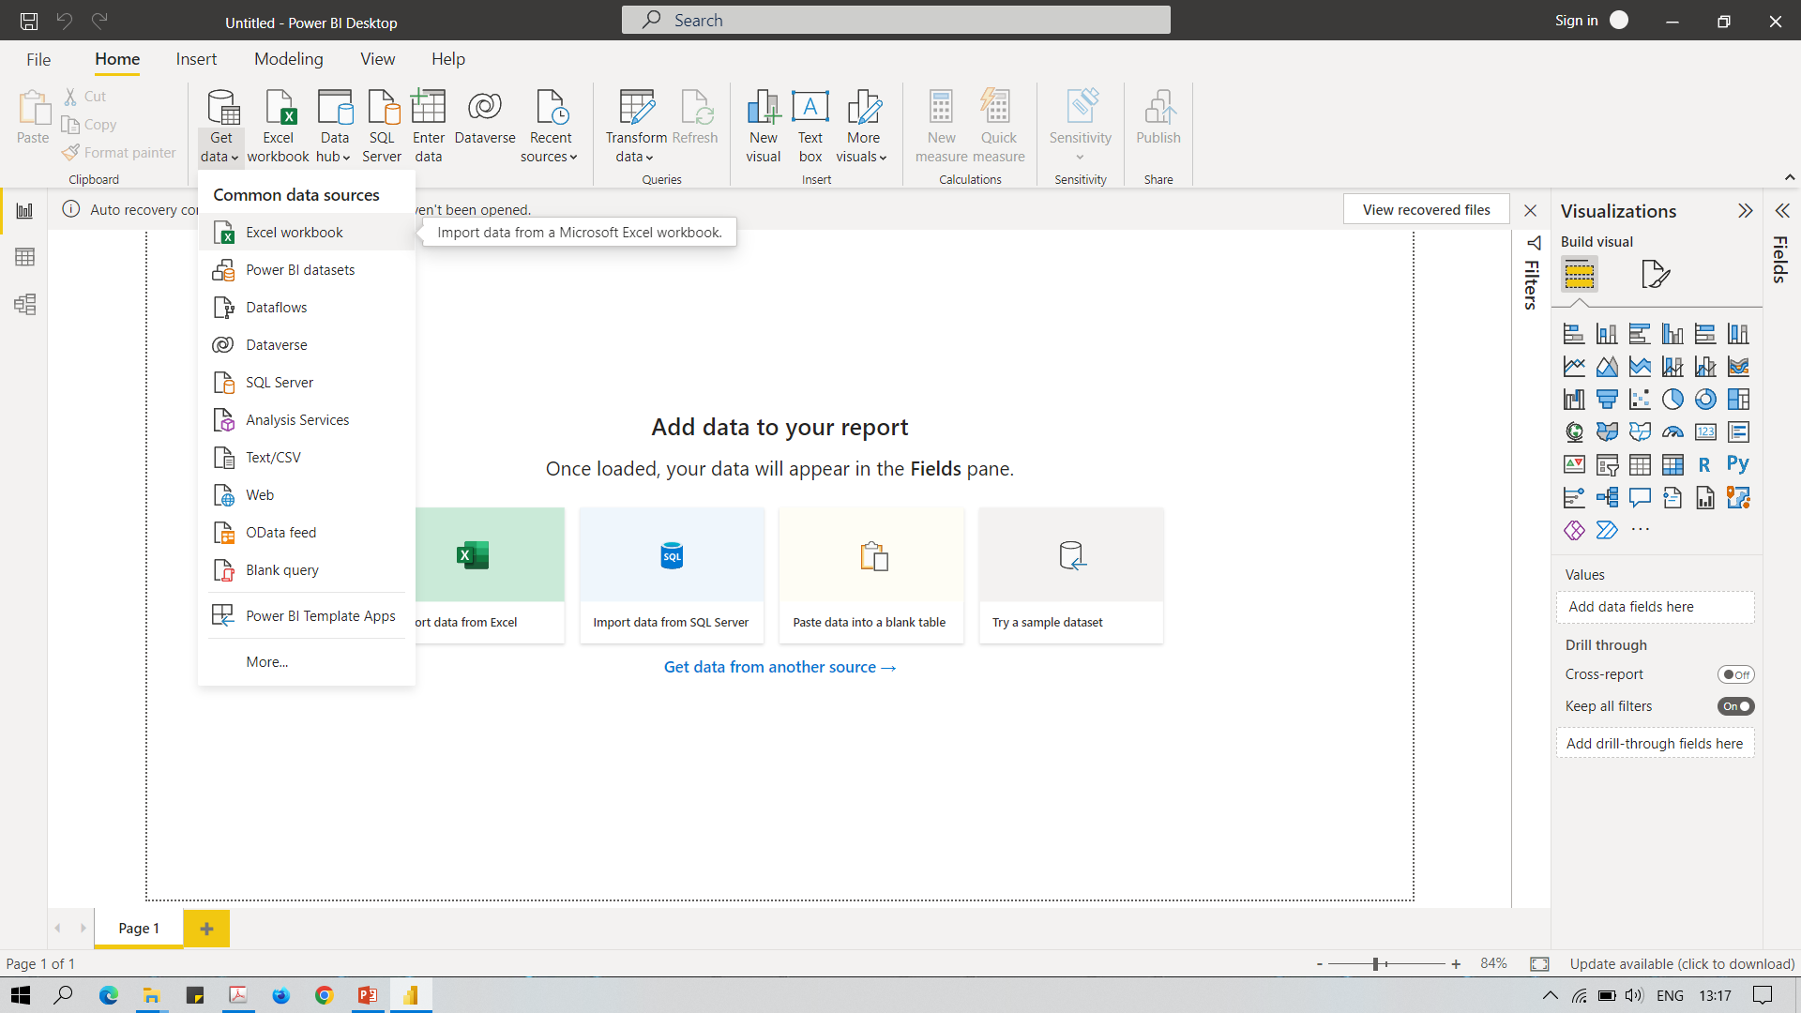
Connecting Power BI to excel
Connecting to excel

Slide 5
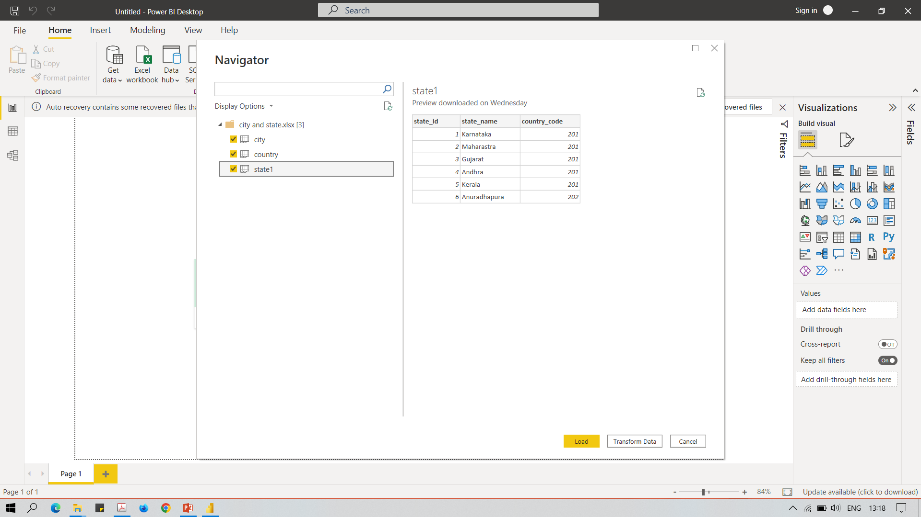
Connecting Power BI to excel

Slide 6
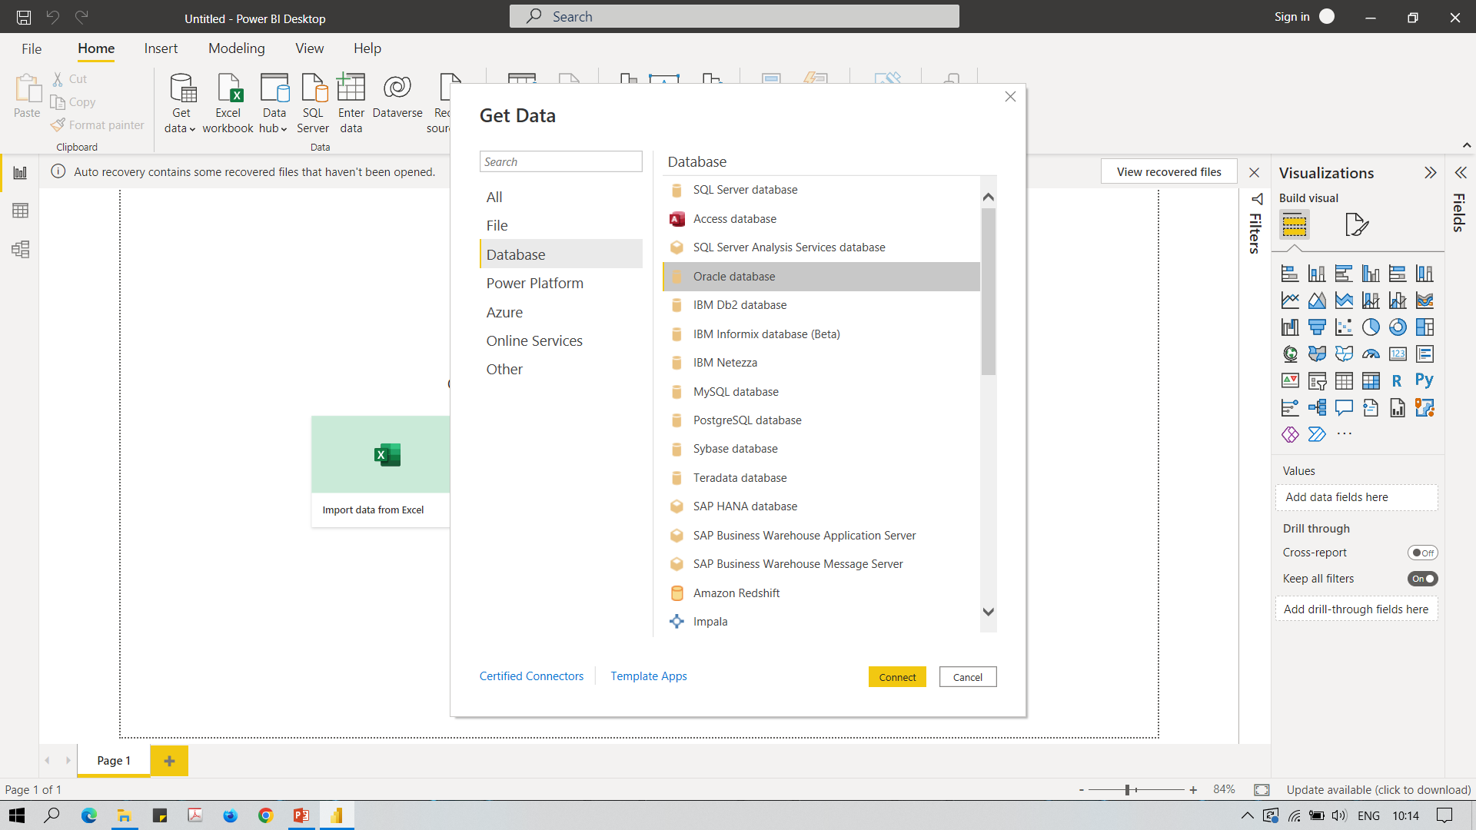
Connect to Oracle Data Base

Slide 7
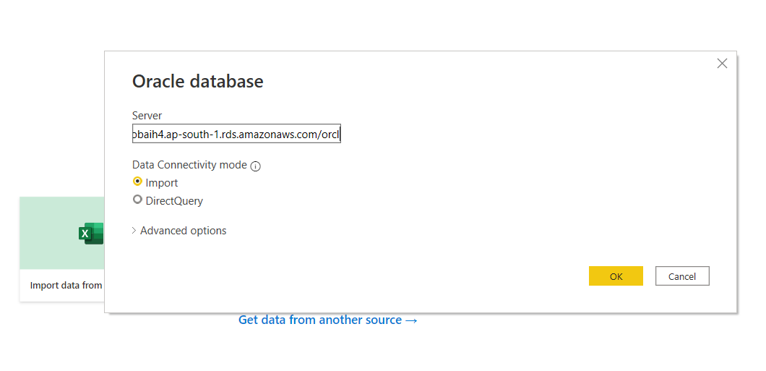
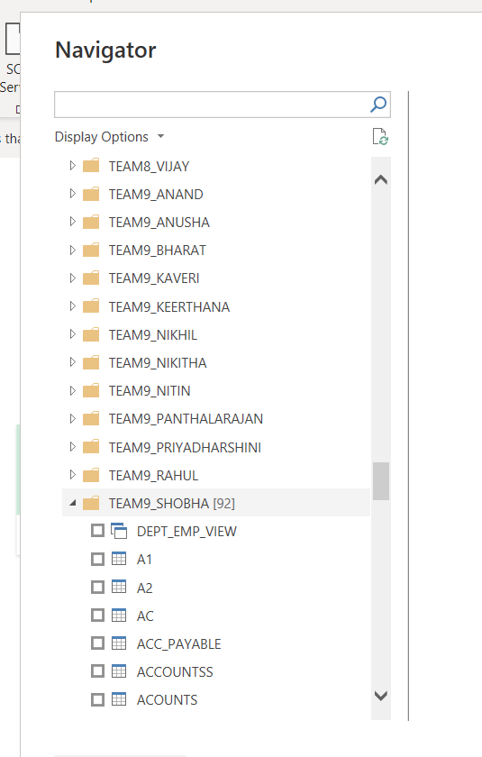
Connect to Oracle Data Base

Slide 8
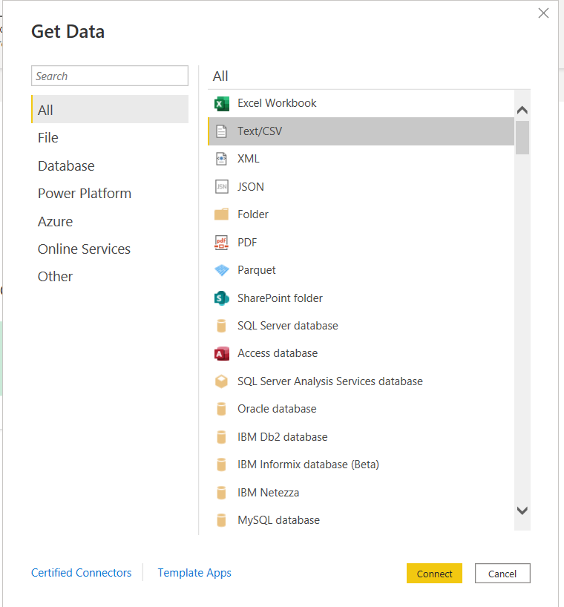
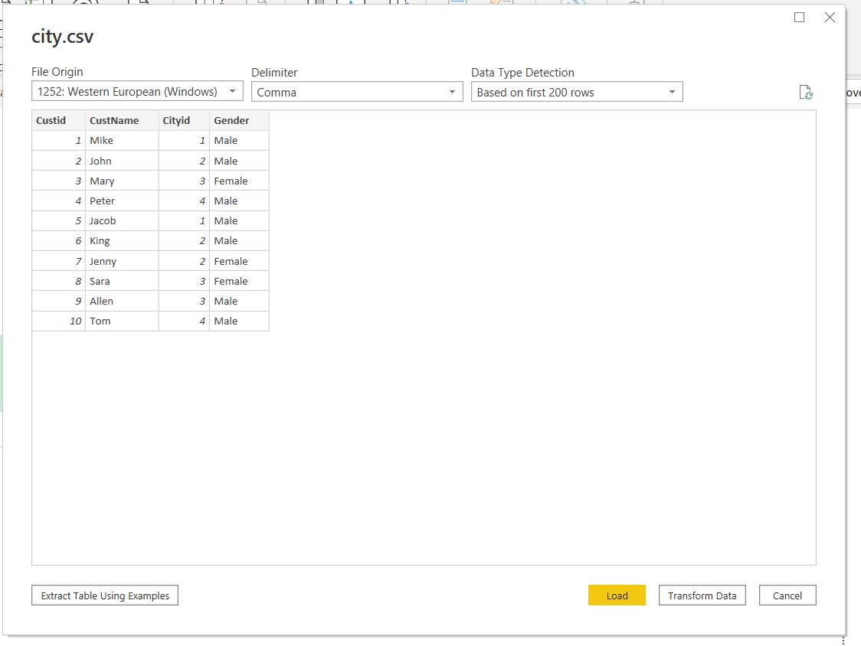
Connect to csv

Slide 9
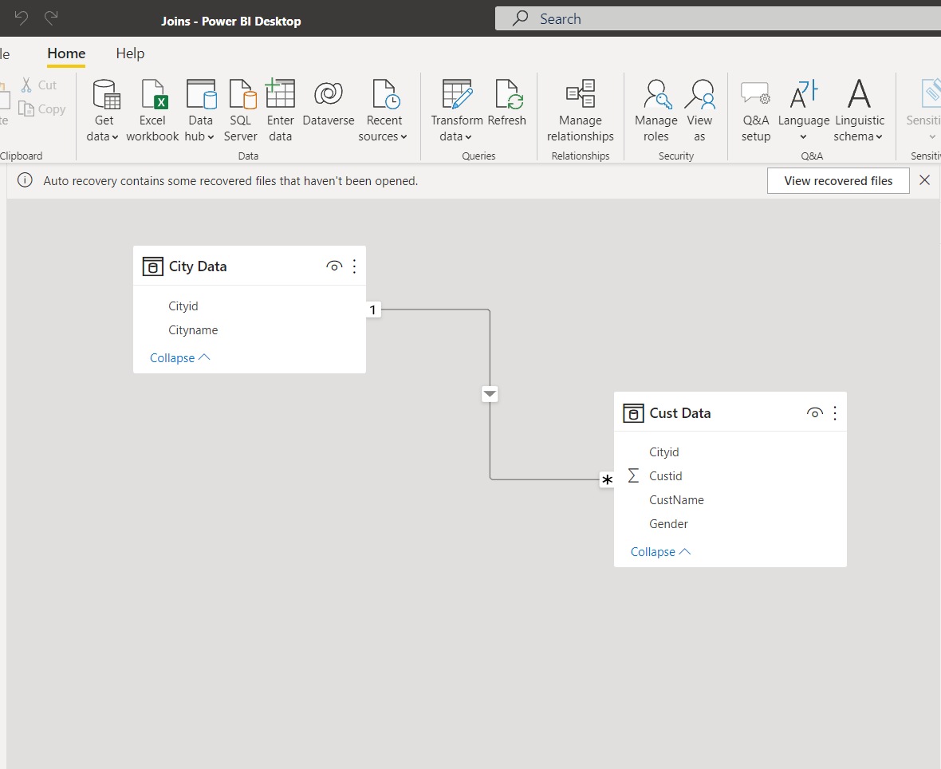
Manage Relationship

Slide 10
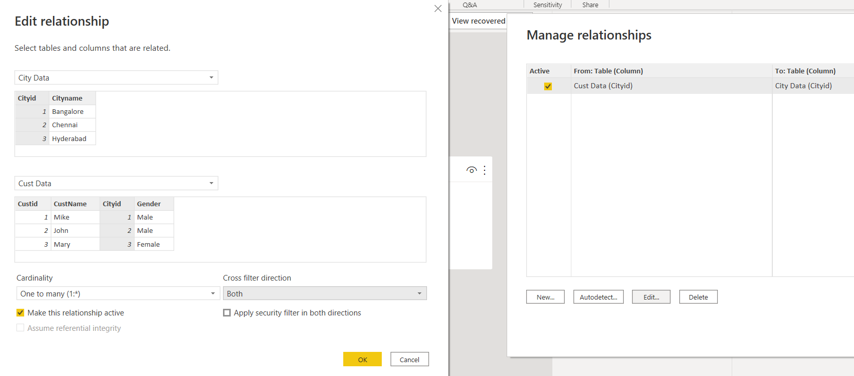
Manage Relationship

Slide 11
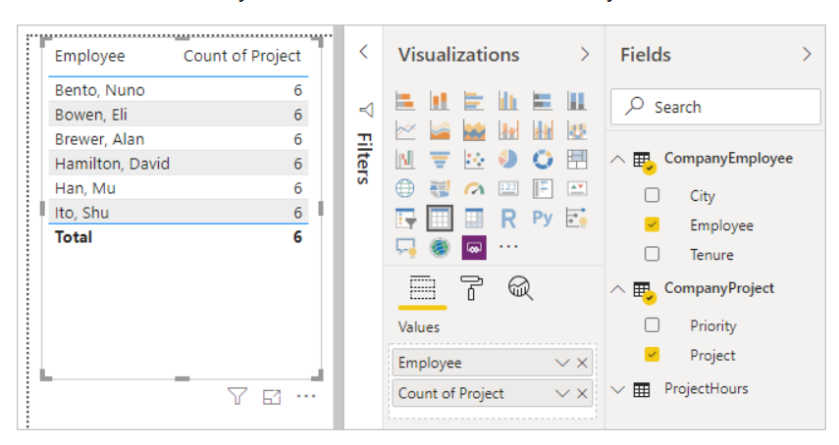
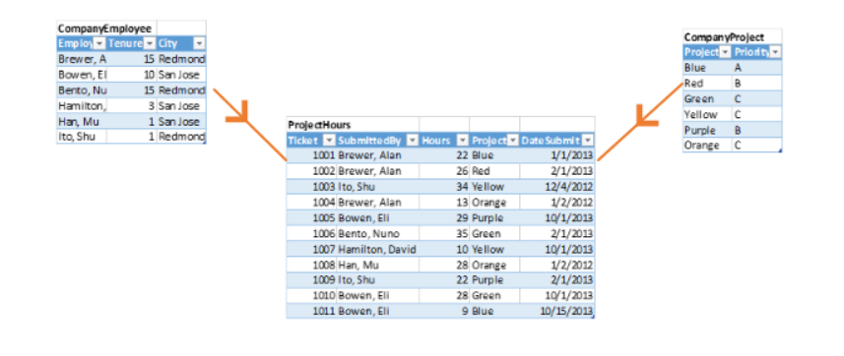
Manage relationship-Single Flow

Slide 12
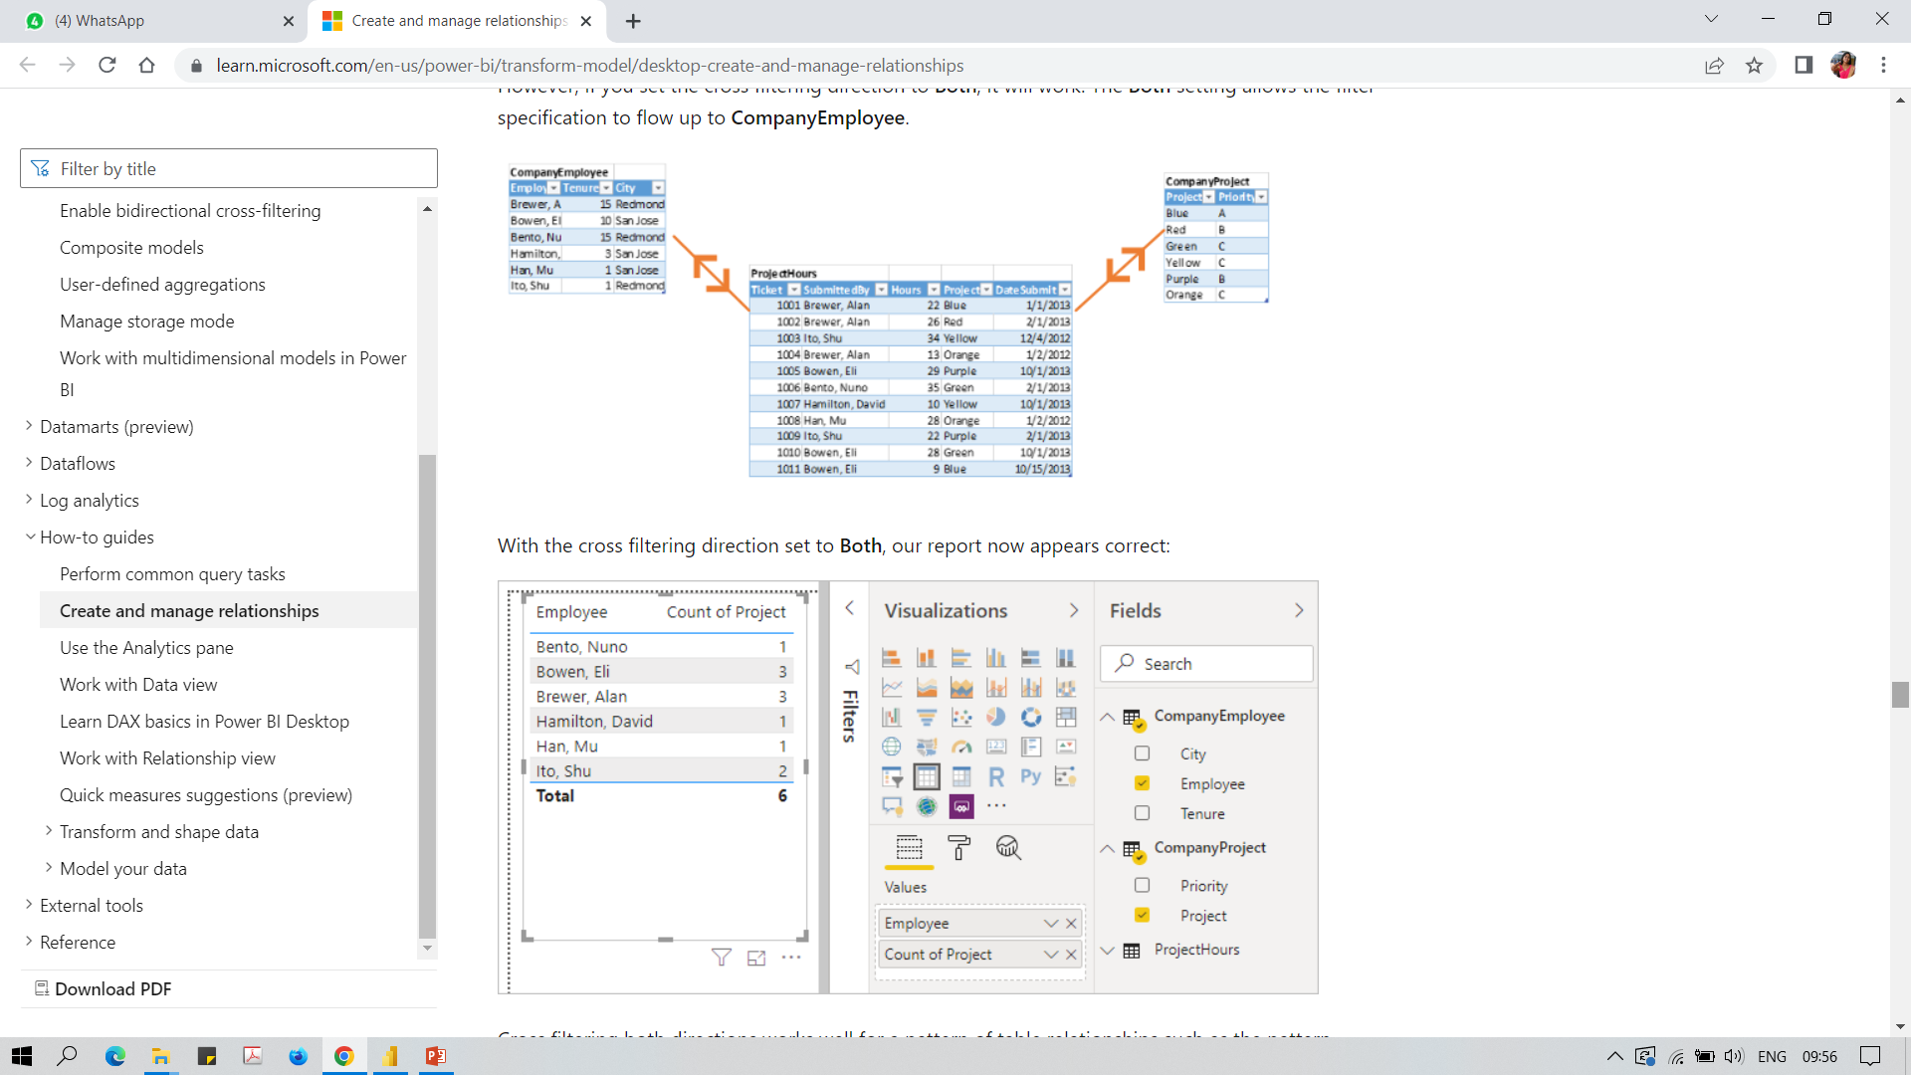
Manage relationship-both side Flow

Slide 13
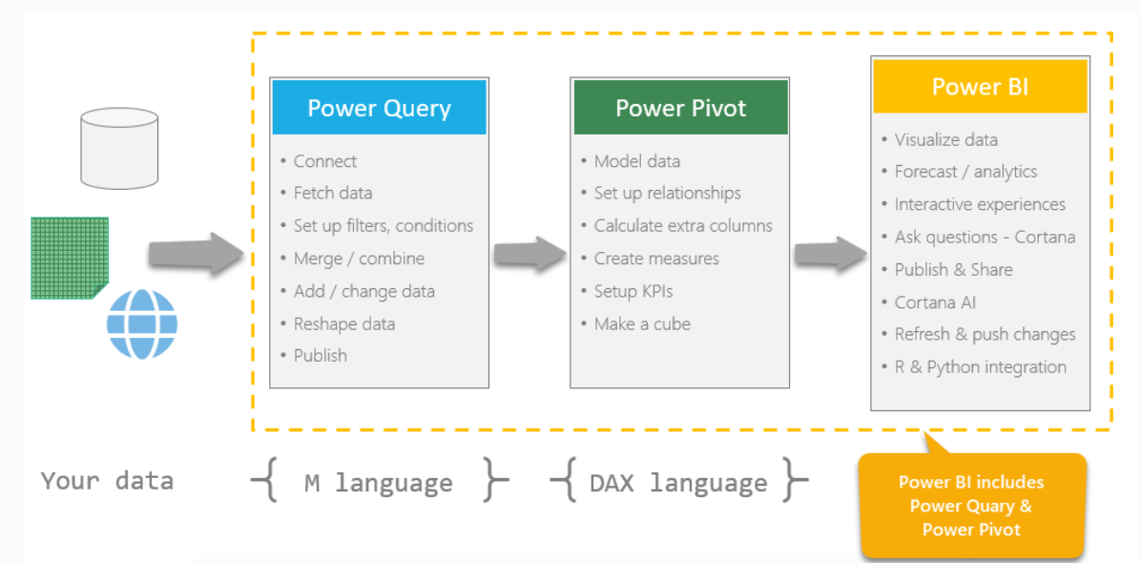
Power Query and Power Pivot

Slide 14
Power Query & Power Pivot
Power Query is an ETL (Extract, Transform, Load) self-service tool that works like an Excel add-in. It allows users to extract data from different sources, manipulate the specified data into a form that matches their needs, and load it into Excel. Back in 2013, a specially created group of developers inside Microsoft released for Excel a free Power Query add-on (other names are Data Explorer, Get and Transform), which can do a lot of useful things for everyday work:
Transform tables in every way by bringing them into the desired view (filter, sort, change the order of columns, transpose, add totals, expand cross-tables into flat ones, and rollback)
Power Pivot
Power Pivot is an in-memory data modeling component that provides highly compressed data storage and extremely fast aggregation and calculation. It is also available as part of Excel and can be used to create a data model in an Excel workbook. Power Pivot can load data by itself or can load data into Power Query. It is very similar to the SSAS (SQL Server Analysis Services) tabular model, which is similar to the server version of Power Pivot.

Slide 15
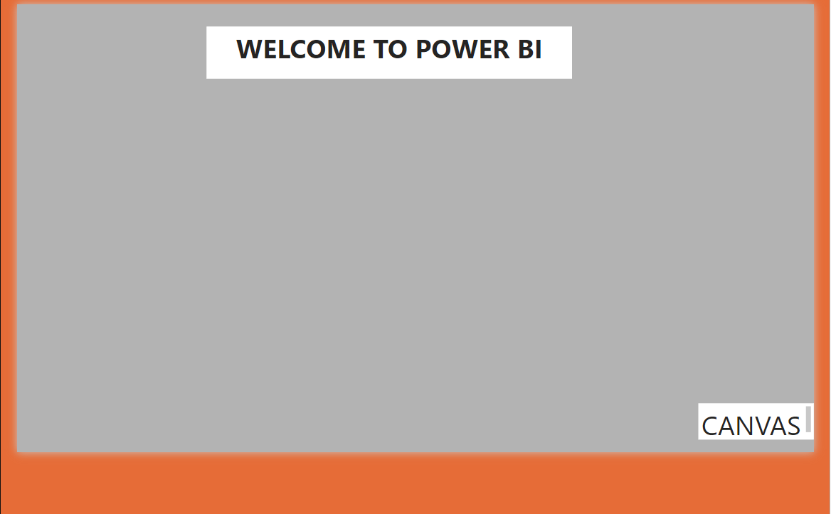
Exploring properties of the canvas
Go to Format your report Page select canvas Setting Explore Size of the canvas and alignment
Go to Format your report Page select canvas background Explore color and transparency
Go to Format your report Page select wallpaper Explore color and transparency
WALL PAPER

Slide 16
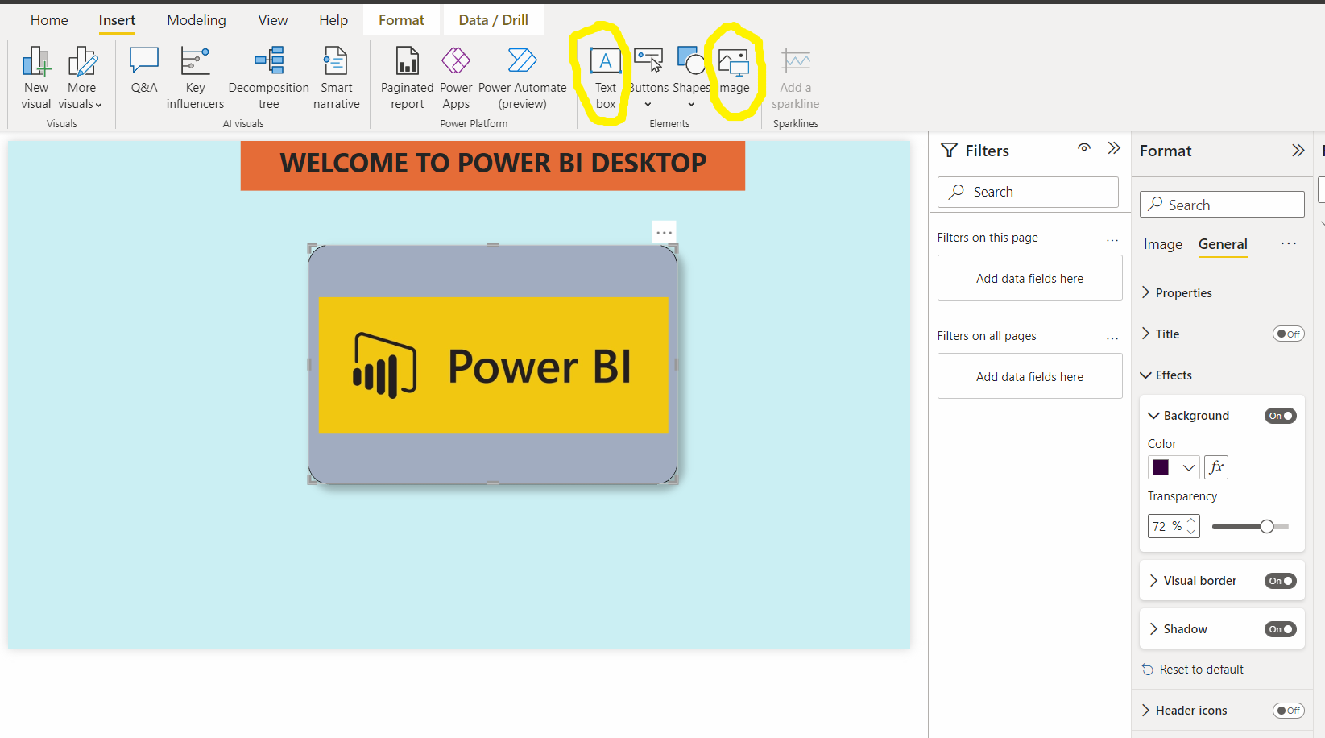
Adding text boxes and images
Text – Explore Font, size, alignment, Background
Image – Explore style
Format Visuals – General
Explore Background color, Visual Border, Shadow

Slide 17
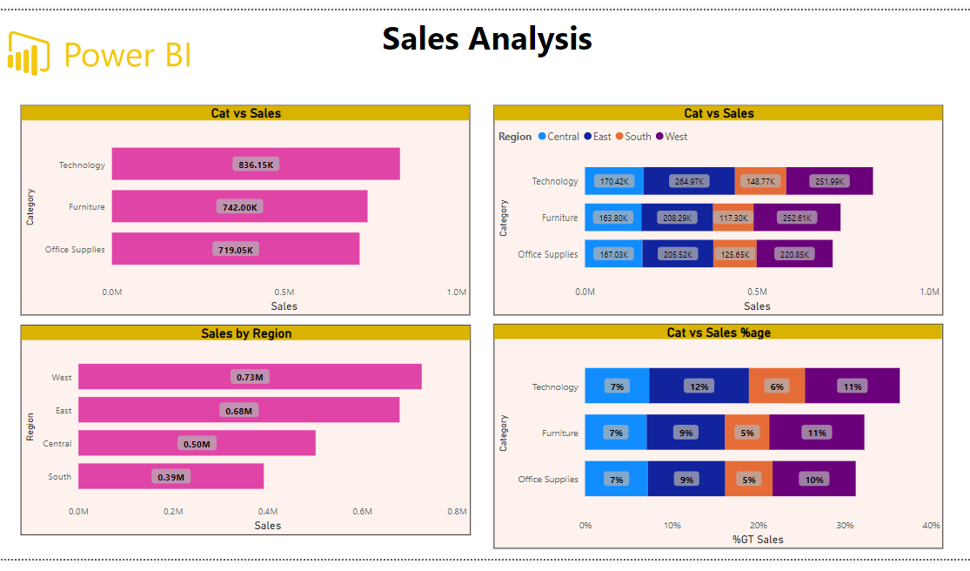
Stacked Bar with all options

Slide 18
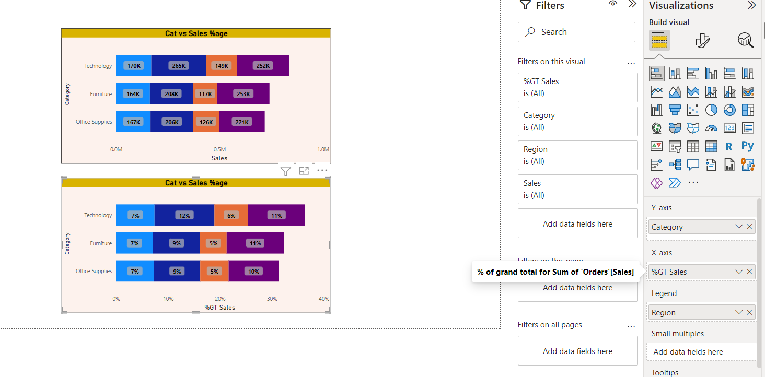
Changing aggregate functions and showing %Age totals

